Slide 1
ING 112A Spring 2021 ONLINE COURSE Week 4- PARAPHRASE
ASLI ÖZKARA ITU, ADVANCED ENGLISH PROGRAM

Slide 2

What did we learn in our last session?
What is plagiarism?
What is citation?
What should be cited?
APA style
In-text citations
Direct quotation

Slide 3
Correct the citation mistakes in the following sentences. (There are 2 mistakes in each one)
1. Jon Butterworth stated “the number of students who claimed Hawking’s book was the moment that they realised physics was cool is still high” (May, 2018).
Jon Butterworth stated “the number of students who claimed Hawking’s book was the moment that they realised physics was cool is still high” (May, 2018).
2. It is explained in Hawking’s book “A Brief History of Time” that stars have collapsed on themselves and formed matter so dense that the laws of physics break down. They distort space time so much as to, in essence, rip it (p. 74, 1988).
It is explained in Hawking’s book A Brief History of Time that stars have collapsed on themselves and formed matter so dense that the laws of physics break down. They distort space time so much as to, in essence, rip it (1988, p. 74).
3. The term postcolonial underlines the fact that colonialism’s legacies have endured in former colonies even after independence (1989, Tiffin and Ashcroft).
The term postcolonial underlines the fact that colonialism’s legacies have endured in former colonies even after independence (Tiffin & Ashcroft, 1989).
4. N. Chomsky argues that children could not learn their first language so quickly and effortlessly without the help of an innate language faculty to guide them (1995, p. 32-33).
N. Chomsky argues that children could not learn their first language so quickly and effortlessly without the help of an innate language faculty to guide them (1995, pp. 32-33).

Slide 4
What are we going to learn today?
What is a paraphrase?
How do we paraphrase a sentence?

Slide 5
There are two methods for borrowing information from an outside source:
Direct quoting
Using the exact copy of the original sentence in between quotation marks (“…”)
Paraphrasing
Rewriting the information in your own words

Slide 6
What is a paraphrase?
Paraphrasing is rewriting the original text by changing the grammatical structure and vocabulary but keeping the meaning the same.

Slide 7
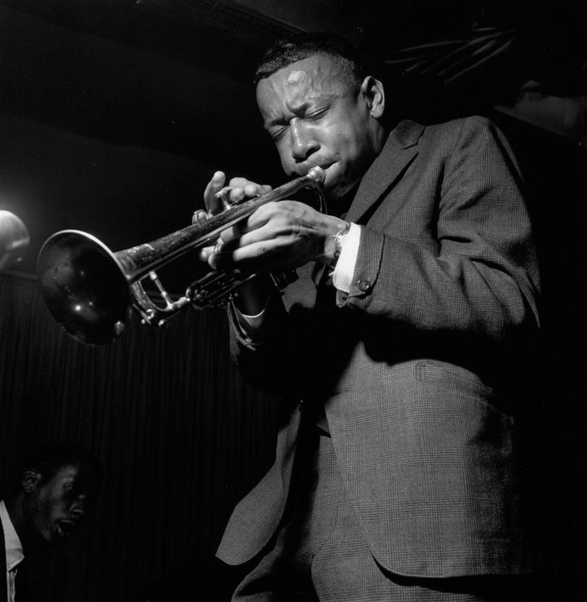
Compare the sentence below with the paraphrased version.
What kind of changes can you see?
Tense?
Sentence structure?
Word forms?
Original Sentence:
Paraphrased sentence:
Jazz has always been popular.
The popularity of jazz is constant.

Slide 8
Steps of paraphrasing:
Make sure that you understand the original text correctly.
Change the sentence structure.
Find synonyms of the words but do not change technical /scientific terms.
Do not change the original meaning.
Do not add your comment.
Remember to cite correctly.

Slide 9
REMEMBER!
Do not copy the author’s style or wording.
Changing a few words to their synonyms will not make it a paraphrase.
It would still be considered plagiarism.

Slide 10
Paraphrase Exercises 1 Read the following example and choose the best paraphrase.
Source: Ted Gioia, The History of Jazz, 2011
1. Original Sentence: By the time of the birth of jazz, New Orleans was already a city in economic and social decline .
A: As Gioia emphasizes, New Orleans was in economic and social decline by the time of the birth of jazz (2011).
B: As Gioia emphasizes, by the time of the emergence of jazz, New Orleans was already a city in economic and social destruction (2011).
C: As Gioia emphasizes, New Orleans had already been an economically and socially depressed city before jazz was born (2011).

Slide 11
Paraphrase Exercises 1 Read the following example and choose the best paraphrase.
Source: Ted Gioia, The History of Jazz, 2011
1. Original Sentence: By the time of the birth of jazz, New Orleans was already a city in economic and social decline .
A: NOT AN ACCEPTABLE PARAPHRASE!
As Gioia emphasizes, New Orleans was already a city in economic and social decline ///// by the time of the birth of jazz (2011).
B: NOT AN ACCEPTABLE PARAPHRASE!
As Gioia emphasizes, by the time of the emergence of jazz, New Orleans was already a city in economic and social destruction (2011).
C: AN ACCEPTABLE PARAPHRASE!
As Gioia emphasizes, New Orleans had already been an economically and socially depressed city before jazz was born (2011).

Slide 12
Paraphrase Exercises 1 Read the following example and choose the best paraphrase.
Source: Ted Gioia, The History of Jazz, 2011
2. Original sentence: The average life span for a black native of New Orleans in 1880s was only thirty-six years; even white inhabitants lived, on average, forty-six years.
A: Gioia explains that the common lifetime for a black citizen of New Orleans in 1880s was only thirty-six years; even white citizens lived, about, forty-six years (2011).
B: Gioia explains that in 1880s, black citizens of New Orleans lived merely thirty-six years on average, and the life expectancy for white citizens was only about ten years longer (2011).

Slide 13
Paraphrase Exercises 1 Read the following example and choose the best paraphrase
Source: Ted Gioia, The History of Jazz, 2011
2. Original sentence: The average life span for a black native of New Orleans in 1880s was only thirty-six years; even white inhabitants lived, on average, forty-six years.
A: NOT AN ACCEPTABLE PARAPHRASE!
Gioia explains that the common lifetime for a black citizen of New Orleans in 1880s was only thirty-six years; even white citizens lived, about, forty-six years (2011).
B: AN ACCEPTABLE PARAPHRASE!
Gioia explains that in 1880s, black citizens of New Orleans lived merely thirty-six years on average, and the life expectancy for white citizens was only about ten years longer (2011).

Slide 14
Paraphrase Exercises 2 Read the original text and choose some specific info to insert into the paragraph below as a paraphrase.
Source: Ted Gioia, The History of Jazz, 2011
“Jazz quickly leaped over the racial barriers that divided New Orleans in the early 1900s. Musicians who were early practitioners of this new idiom also included of black European descent such as Sidney Bechet, Jelly Roll Morton, and Kid Ory, as well as white players Papa Jack Laine and Emmett Hardy. By the 1920s, the ethnic mix of the local bands was almost as diverse as the city’s population.”
Although jazz is known to be the music of black people, during the first decades of the twentieth century, New Orleans jazz bands included musicians with various ethnicities. Gioia lists ………………………………………………………………………………………………..(2011). This diversity, indeed, made jazz a popular music enjoyed by all parts of society.

Slide 15
Paraphrase Exercises 2 Read the original text and choose some specific info to insert into the paragraph below as a paraphrase.
Source: Ted Gioia, The History of Jazz, 2011, p. 35
“Jazz quickly leaped over the racial barriers that divided New Orleans in the early 1900s. Musicians who were early practitioners of this new idiom also included of black European descent such as Sidney Bechet, Jelly Roll Morton, and Kid Ory, as well as white players Papa Jack Laine and Emmett Hardy. By the 1920s, the ethnic mix of the local bands was almost as diverse as the city’s population.”
Although jazz is known to be the music of African-American people, during the first decades of the twentieth century, New Orleans jazz bands included musicians with various ethnicities. Gioia lists some of the jazz musicians who had no African American origins as Sidney Bechet, Jelly Roll Morton, Kid Ory, Papa Jack Laine and Emmett Hardy (2011, p.35). This diversity, indeed, made jazz a popular music enjoyed by all parts of the society.

Slide 16
Paraphrase Exercises 3 Complete the sentences by changing the sentence structure.
1. Physics and Chemistry have certain similarities.
(a) Physics is …
(b) Certain …
1(a) Physics is similar to Chemistry in certain respects (not “aspects”) 1(b) Certain similarities exist between Physics and Chemistry.

Slide 17
Paraphrase Exercises 3
2. Very few people live for more than 100 years.
(a) The number …
(b) The human life span…
2(a) The number of people who live beyond 100 years is small. 2(b) The human life span rarely exceeds 100 years.

Slide 18
Paraphrase Exercises 3
3. It is many years since the moon landing. (a) Since …
(b) The moon landing ...
3(a) Since the moon landing, many years have passed. 3(b) The moon landing happened many years ago.

Slide 19
Paraphrase Exercises 4 Paraphrase the sentences below: SOURCE: Bhatt, J. J., 1978
Oceans cover approximately 140 million of the total of 200 million square miles of the earth’s surface.
the total area of oceans / Oceans extend / Oceans occupy / is occupied by oceans
total surface area of the earth
140 million square miles on earth’s surface
surface of earth
on 200 million square miles earth’s surface
the 7/10
which is totally 200 million miles

Slide 20
Paraphrase Exercises 4 1. Oceans cover approximately 140 million of the total of 200 million square miles of the earth’s surface.
Bhatt states that the total area of oceans on 200 million square miles earth’s surface is nearly 140 million (1978).
As Bhatt states total surface area of the earth is 200 million square miles, nearly 140 million of which is occupied by oceans (1978).
Bhatt (1978) indicates that oceans extend nearly 140 million square miles on earth’s surface, which is totally 200 million miles.
Oceans occupy nearly the 7/10 of the 200 million square miles surface of earth (Bhatt, 1978).

Slide 21
Paraphrase Exercises 4 Paraphrase the sentences below: SOURCE: Bhatt, J. J., 1978
2. Oceans also contain millions of tons of fish and other related seafoods which offer a great hope to solve the world’s food problems.
masses of fish and seafoods / in great abundance / fish and seafoods in oceans /the abundant supply of / huge volume of
might be an answer to / to overcome / could be the solution / raise the possibility / to find a solution / might supply nourishment
the food problems in the world/ the hungry world / the scarcity of food

Slide 22
Paraphrase Exercises 3 2. Oceans also contain millions of tons of fish and other related seafoods which offer a great hope to solve the world’s food problems.
In addition, oceans consist of masses of fish and seafoods which might be an answer to the food problems in the world (Bhatt, 1978).
Moreover, to overcome the food problems in the world, oceans could be the solution owing to their huge volume of fish and seafoods (Bhatt, 1978).
Furthermore, the abundant supply of fish and seafoods in oceans raise the possibility to find a solution to the scarcity of food for the populations (Bhatt, 1978).
Additionally, fish and seafoods in oceans are in great abundance that this might supply nourishment to the hungry world (Bhatt, 1978).

Slide 23
Paraphrase Exercises 4 Paraphrase the sentences below: SOURCE: Bhatt, J. J., 1978
3. Because of their large volume and rapid fluidity, oceans are remarkably self-purifying and have thus managed to survive uncontaminated for so long.
because / due to / therefore
a huge body of water / water capacity
in constant flow / fast motion
notable(ly) / impressive(ly)
can cleanse themselves / the ability of oceans to decontaminate themselves
could exist unpolluted / have been able to endure contamination
for a long period of time / for centuries

Slide 24
Paraphrase Exercises 4 3. Because of their large volume and rapid fluidity, oceans are remarkably self-purifying and have thus managed to survive uncontaminated for so long.
As stated by Bhatt, oceans can cleanse themselves notably because they contain a huge body of water and they are in constant flow; therefore, oceans could exist unpolluted for a long period of time (1978).
As stated by Bhatt (1978), oceans have been able to endure contamination for centuries because the ability of oceans to decontaminate themselves is impressive due to their water capacity and fast motion.

Slide 25
Paraphrase Exercises 4 Paraphrase the sentences below: SOURCE: Bhatt, J. J., 1978
4. Desalinated water from oceans could increase terrestrial production of food.
desalted ocean water / fresh water distilled from oceans / desalination
might be enhanced / might lead to an increase / it is possible to
produce more food / producing food / food production
on land

Slide 26
Paraphrase Exercises 4 4. Desalinated water from oceans could increase terrestrial production of food.
Producing food on land might be enhanced by using desalted ocean water (Bhatt, 1978).
Fresh water distilled from oceans might lead to an increase in food production (Bhatt, 1978).
It is possible to produce more food on land by desalination (Bhatt, 1978).

Slide 27
SEE YOU IN THE NEXT SESSION !
STAY HEALTHY!
STAY CONFIDENT!
DON’T FORGET TO FOLLOW THE ANNOUNCEMENTS ON NINOVA☺

